Slide 1
Introduction to programming in R for Biologist
Mohammad umer sharif shohan

Slide 2
IntroduceꢀRꢀwellꢀenoughꢀtoꢀunderstandꢀsomeꢀ
basicsꢀandꢀfeelꢀcomfortableꢀtryingꢀthingsꢀonꢀ
theirꢀown
2

Slide 3
Who has experience with programming?

Slide 4
Previous experience with algorithms
Who has already executed an algorithm?

Slide 5
Previous experience with algorithms
Who has already executed an algorithm? Examples:
Follow a recipe from a book to cook.
Decipher instructions to configurate a device..

Slide 6
Previous experience with algorithms
Who has already written an algorithm?

Slide 7
Previous experience with algorithms
Who has already written an algorithm? Examples:
Indicate the way to the to someone how to go from Shahbag to Gulshan
Write instructions for your parents on how to use the printer / email / zoom/ mobile.

Slide 8
Definition
An algorithm is a list of instructions that, upon correct execution, lead to a wanted result.

Slide 9
This Week
z The R programming language
• Syntax and constructs
• Variable initializations
• Function declarations
• Function declarations
z Introduction to R Graphics Functionality
• Some useful functions

Slide 10
What is R?
A free software for statistical analysis and graphics
The R Project
z Environment for statistical computing
and graphics
• Free software
z Associated with simple programming
language
• Similar to S and S-plus
z www.r-project.org

Slide 11
The R Project
z Versions of R exist of Windows, MacOS, Linux
and various other Unix flavors
z R was originally written by Ross Ihaka and
Robert Gentleman, at the University of
Auckland
z It is an implementation of the S language,
which was principally developed by John
Chambers

Slide 12
Introducing RStudio
RStudio allows the user to run R in a more user-friendly
environment. It is open-source (i.e. free) and available at
http://www.rstudio.com/
2
DSS/OTR

Slide 13
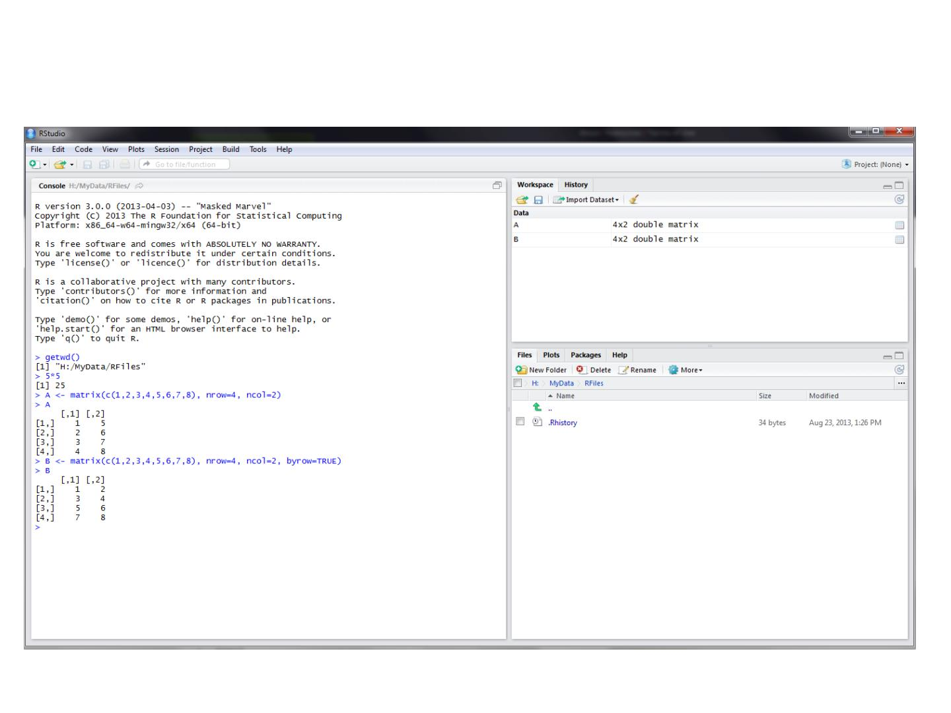
RStudio screen
The workspace tab shows all the active
objects (see next slide). The history tab
shows a list of commands used so far.
The files tab shows all the files and folders
in your default workspace as if you were on
a PC/Mac window. The plots tab will show
all your graphs. The packages tab will list a
series of packages or add-ons needed to
run certain processes. For additional info
see the help tab
The console is where you can type
commands and see output
3
DSS/OTR

Slide 14
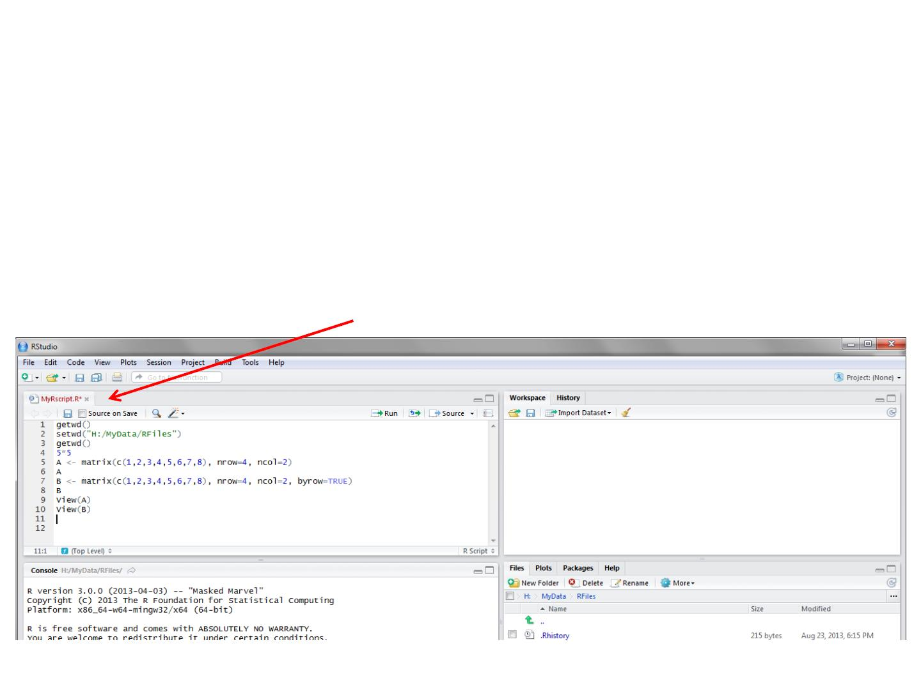
R script (1)
The usual Rstudio screen has four windows:
1. Console.
2. Workspace and history.
3. Files, plots, packages and help.
4. The R script(s) and data view.
The R script is where you keep a record of your work. For Stata users this would be like the
do-file, for SPSS users is like the syntax and for SAS users the SAS program.
9
DSS/OTR

Slide 15
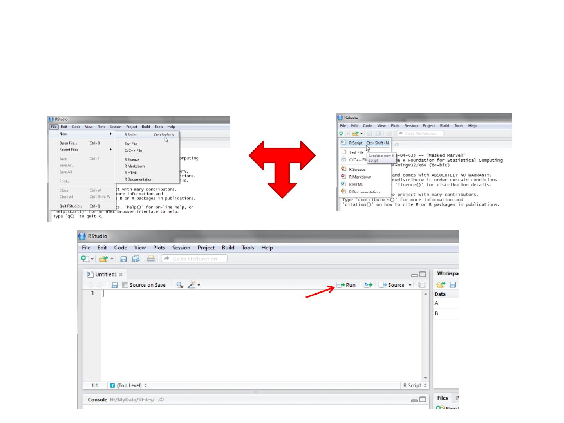
R script (2)
To create a new R script you can either go to File -> New -> R Script, or click on the
icon with the “+” sign and select “R Script ”, or simply press Ctrl+Shift+N. Make sure to save
the script.
Here you can type R commands and run them. Just
leave the cursor anywhere on the line where the
command is and press Ctrl-R or click on the ‘Run’
icon above. Output will appear in the console below.
10
DSS/OTR

Slide 16
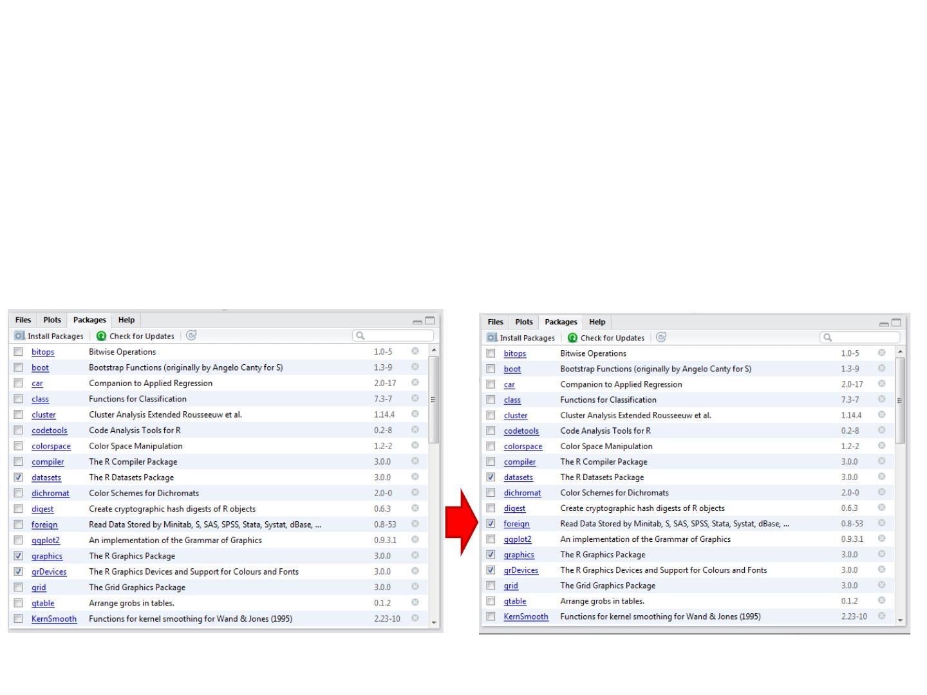
Packages tab
The package tab shows the list of add-ons included in the installation of RStudio. If checked,
the package is loaded into R, if not, any command related to that package won’t work, you
will need select it. You can also install other add-ons by clicking on the ‘Install Packages’ icon.
Another way to activate a package is by typing, for example, library(foreign).This
will automatically check the --foreignpackage (it helps bring data from proprietary
formats like Stata, SAS or SPSS).
11
DSS/OTR

Slide 17
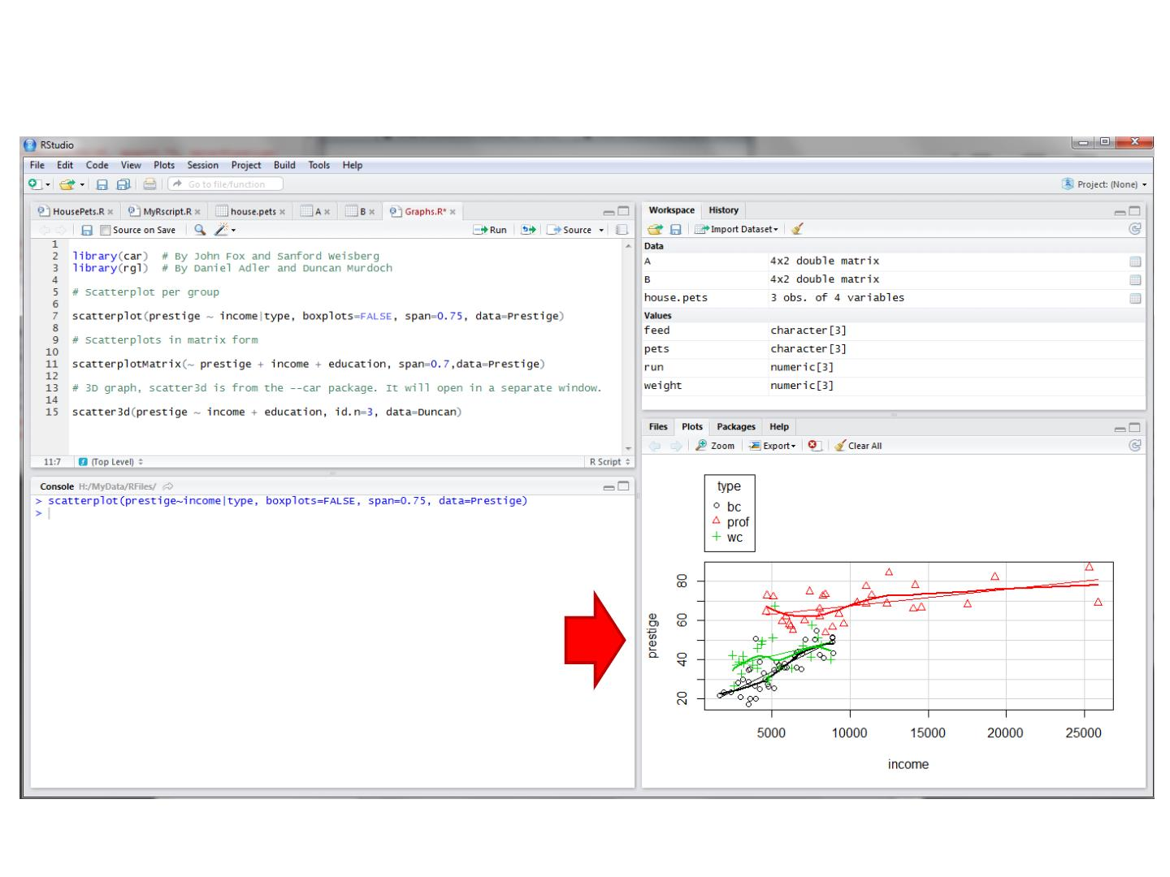
Plots tab (1)
The plots tab will display the graphs.
The one shown here is created by
the command on line 7 in the script
above.
See next slide to see what happens
when you have more than one graph
13
DSS/OTR

Slide 18
R as a Calculator
> 1 + 1
# Simple Arithmetic
[1] 2
> 2 + 3 * 4 # Operator precedence
[1] 14
> 3 ^ 2
# Exponentiation
[1] 9
> exp(1)
[1] 2.718282
> sqrt(10)
[1] 3.162278
> pi
# Basic mathematical functions are available
# The constant pi is predefined
[1] 3.141593
> 2*pi*6378 # Circumference of earth at equator (in km)
[1] 40074.16

Slide 19
R as a Smart Calculator
> x <- 1
> y <- 3
> z <- 4
> x * y * z
[1] 12
# Can define variables
# using "<-" operator to set values
> X * Y * Z
# Variable names are case sensitive
Error: Object "X" not found
> This.Year <- 2004 # Variable names can include period
> This.Year
[1] 2004

Slide 20
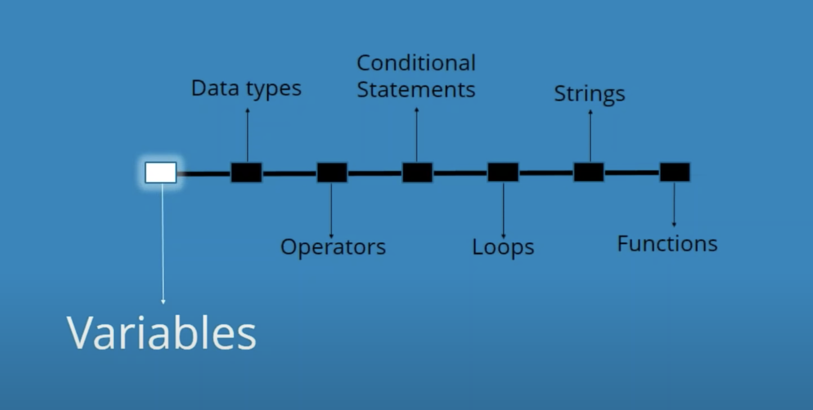

Slide 21
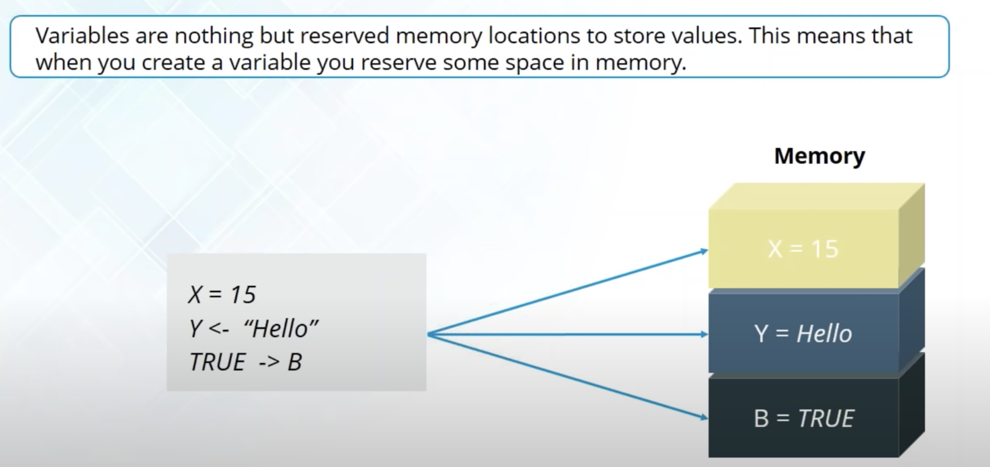
Variables

Slide 22
Variables in R
z Numeric
• Store floating point values
z Boolean (T or F)
• Values corresponding to True or False
z Strings
• Sequences of characters
z Type determined automatically when variable
is created with "<-" operator

Slide 23
R does a lot more!
z Definitely not just a calculator
z R thrives on vectors
z R has many built-in statistical and
graphing functions

Slide 24
R Vectors
A series of numbers
Created with
•c() to concatenate elements or sub-vectors

Slide 25
Defining Vectors
> x <- c(2,0,0,4) # Creates vector with elements 2,0,0,4
> y <- c(1,9,9,9)
> x + y
# Sums elements of two vectors
[1] 3 9 9 13
> x * 4
# Multiplies elements
[1] 8 0 0 16
> sqrt(x)
# Function applies to each element
[1] 1.41 0.00 0.00 2.00 # Returns vector

Slide 26
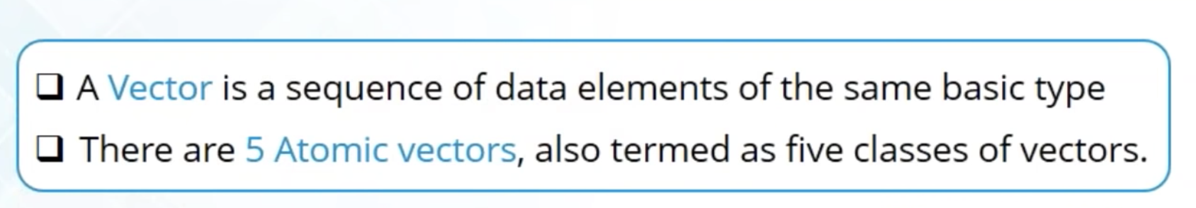
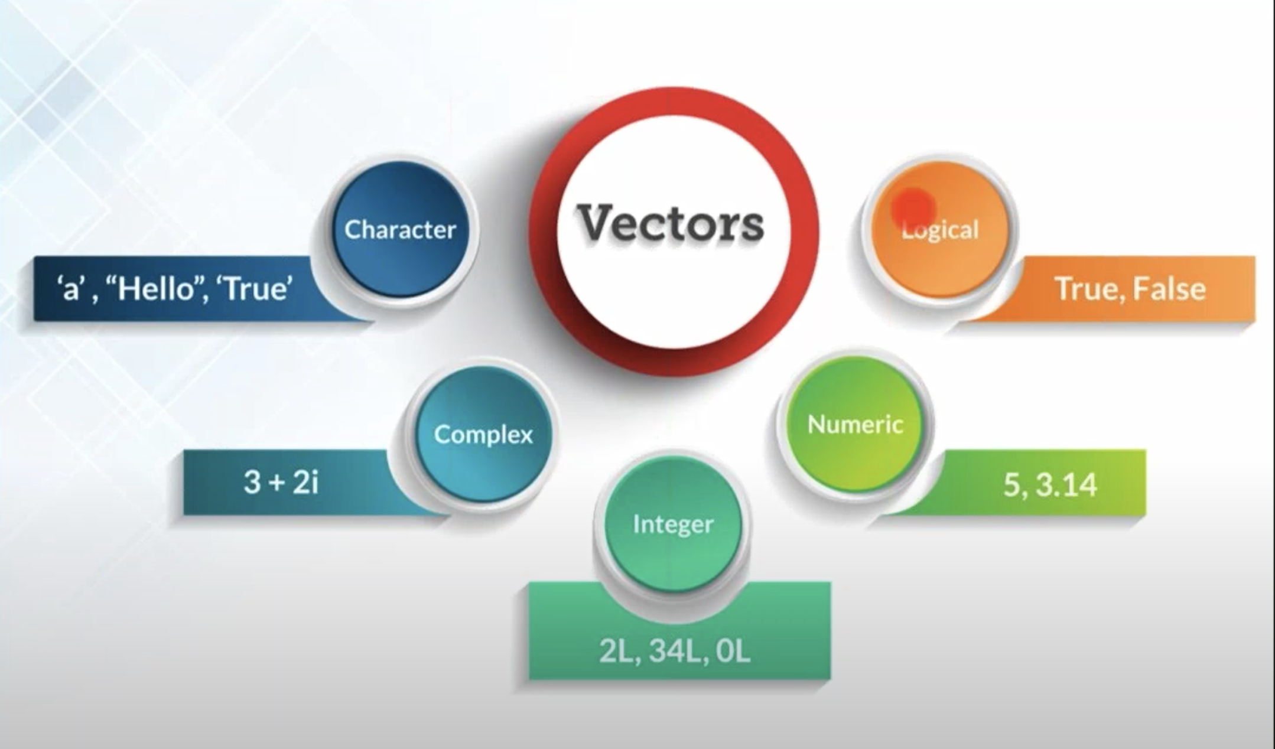

Slide 27
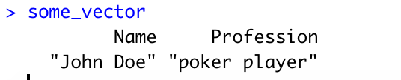
Naming A Vector
some_vector <- c("John Doe", "poker player")
names(some_vector) <- c("Name", "Profession")

Slide 28
Accessing Vector Elements
z Use the []operator to select elements
z To select specific elements:
• Use index or vector of indexes to identify them
z To exclude specific elements:
• Negate index or vector of indexes
z Alternative:
• Use vector of T and F values to select subset of elements

Slide 29
Accessing Vector Elements
> x <- c(2,0,0,4)
> x[1]
# Select the first element, equivalent to x[c(1)]
[1] 2

Slide 30
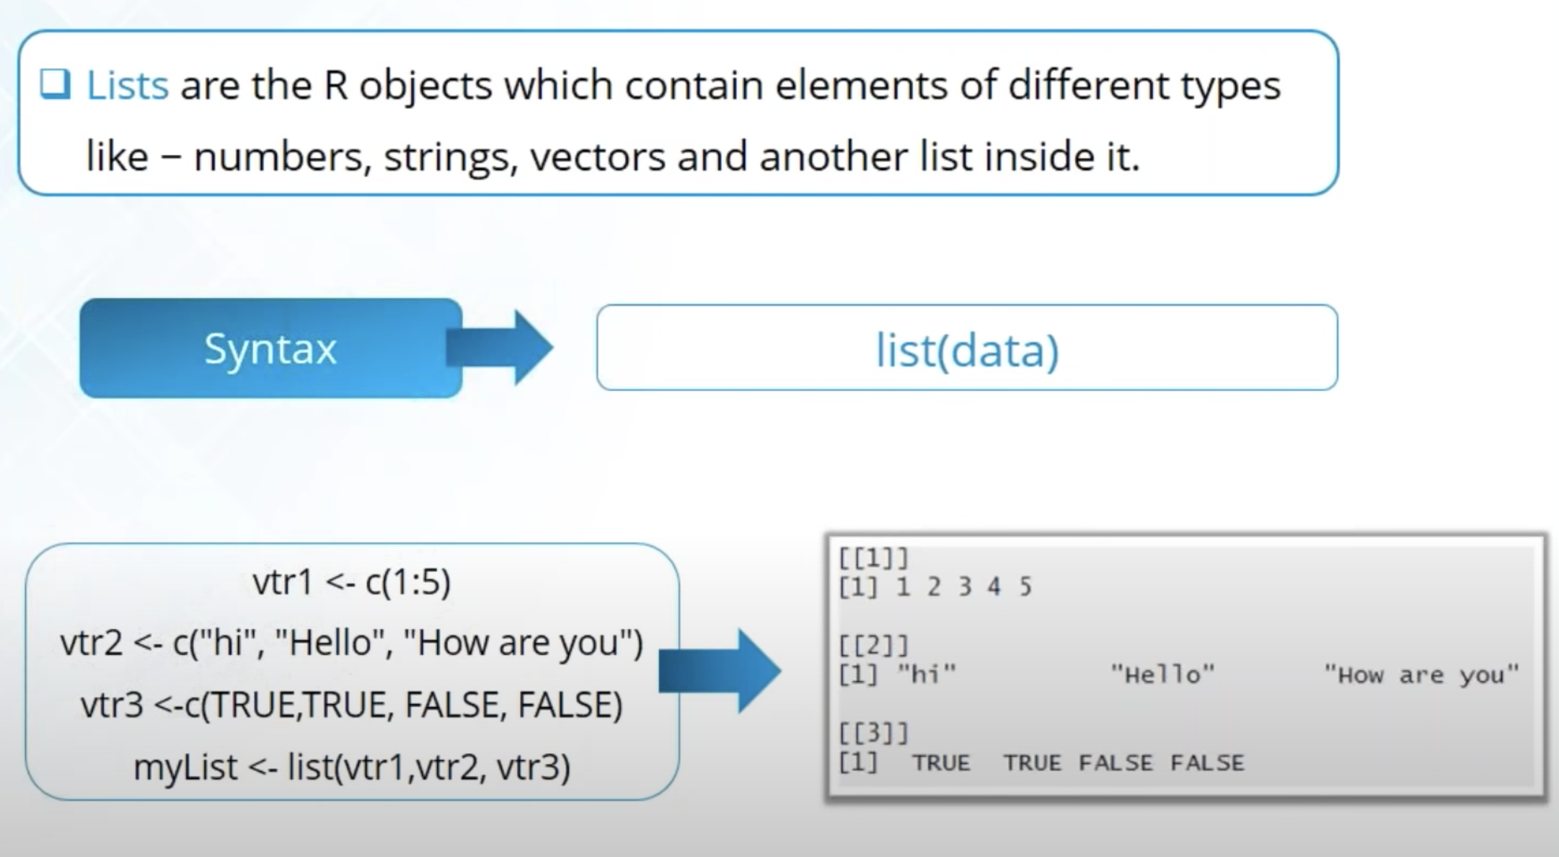

Slide 31
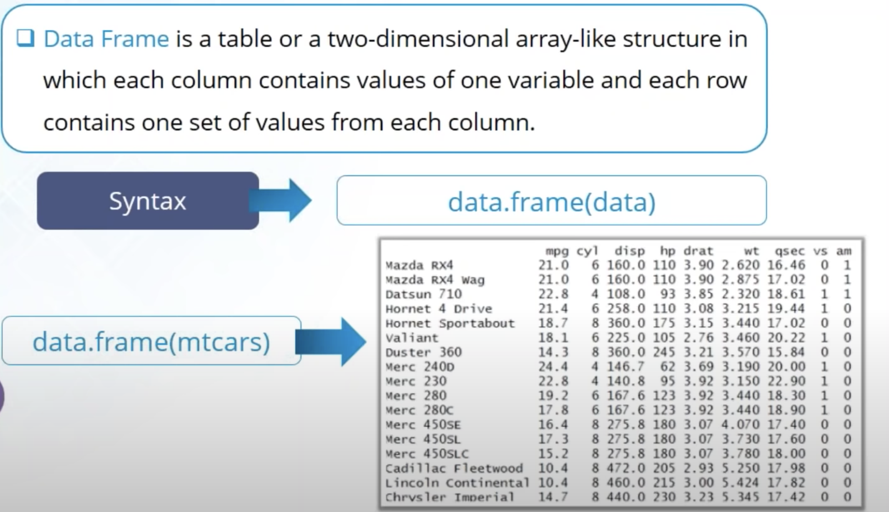

Slide 32
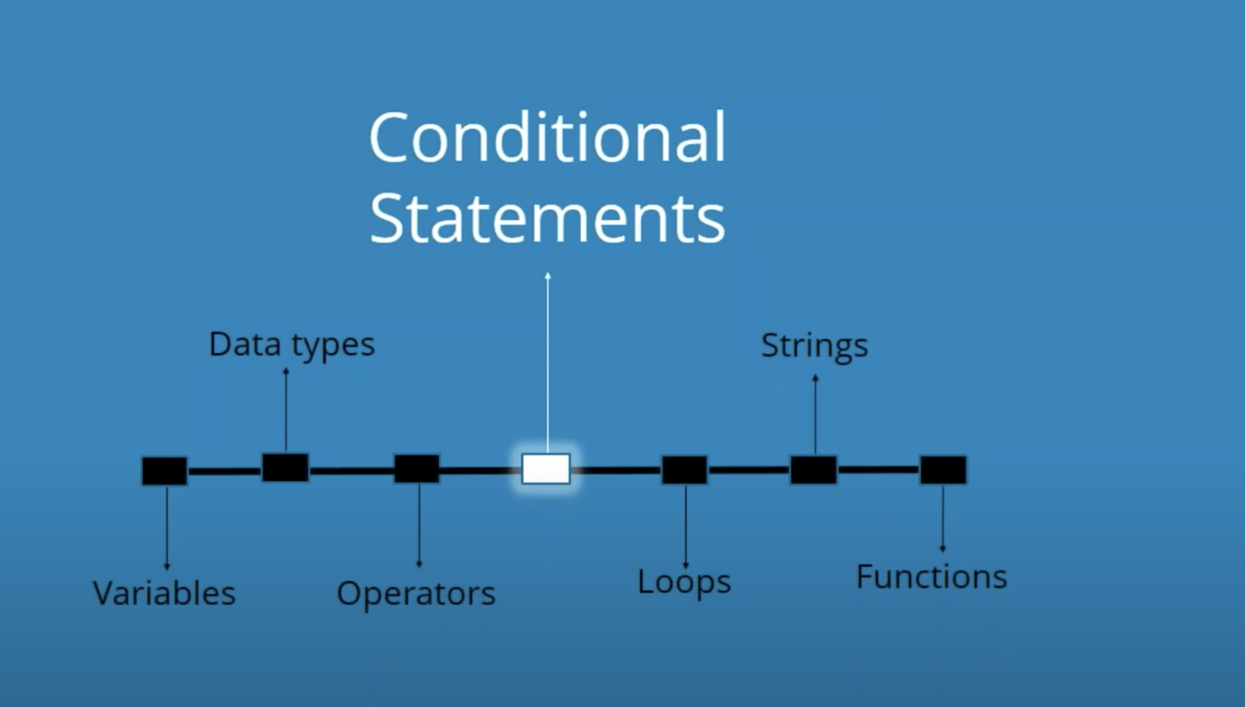

Slide 33
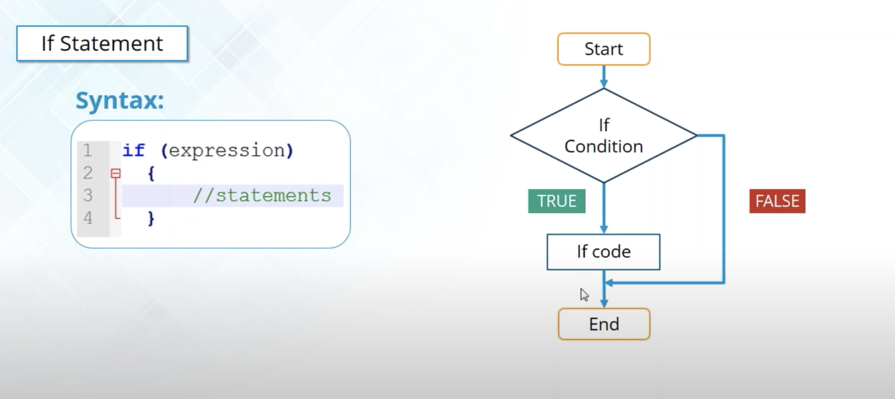

Slide 34
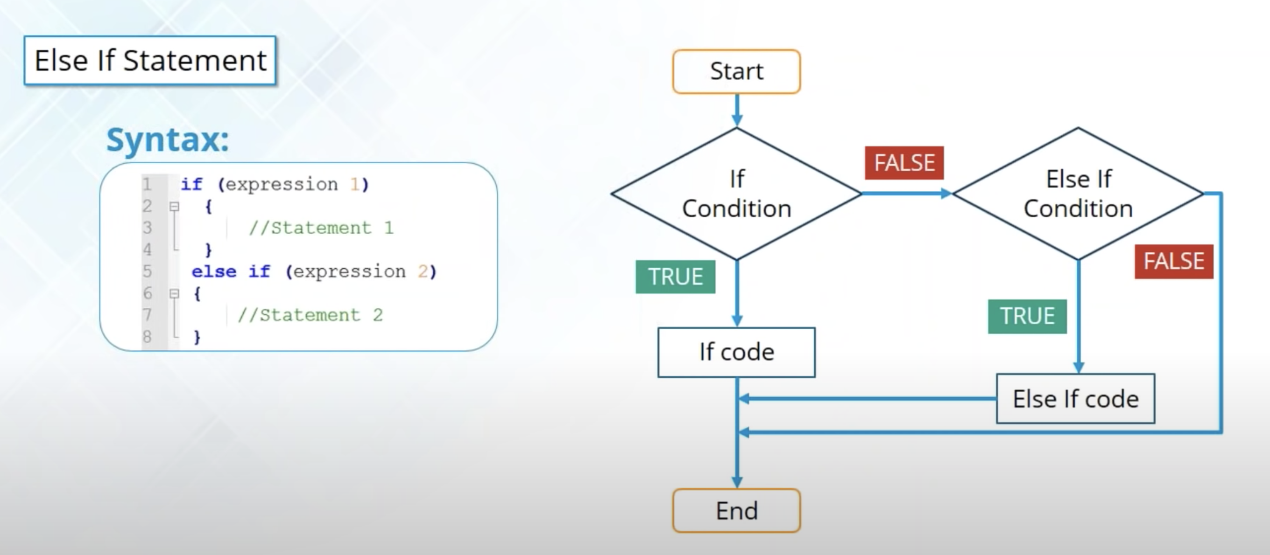

Slide 35
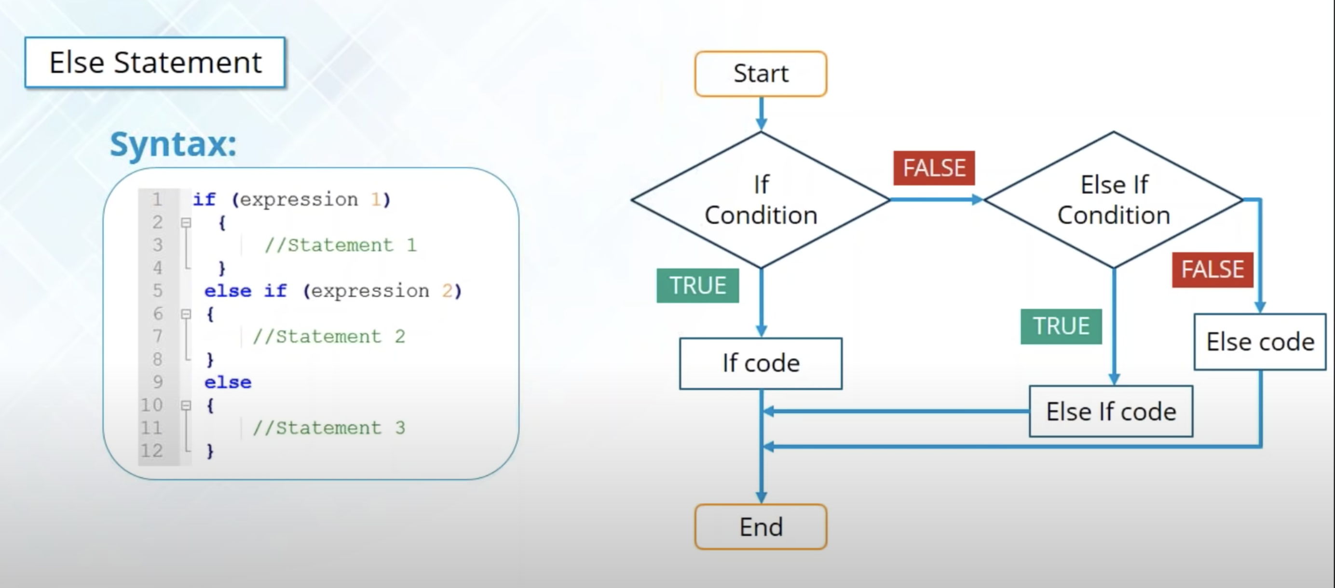

Slide 36
